Slide 1
Some Examples and Results of Point Approximation Algorithms
Karl Skretting
Department of Electrical and Computer Engineering, University of Stavanger, 4036 Stavanger, Norway
NOBIM 2023, 7-8 June, Tromsø

Slide 2
The points are assumed to be samples of a curve
The curve is given by a set of points in 1D, 2D or M-D
The points may be a set of measurements (samples) at uniform or given times of an continuous signal (curve).
Example: sampled geographic positions, gpx-file as recorded by a training watch or phone application. (x,y,z)(t)
The points may also be without ‘time’, simply a set of {(x,y,..)} perhaps even without a specific ordering or start.
Example: a set of image pixels defining the contour or outline of an object
The task is to approximate (use fewer points in representation) of curve, track, path, line(s), contour or outline

Slide 3
GPX track
From Polar Sport Watch
One sample for each second (3 hours is 10800 points)
Larger error the first few minutes
Systematic (non-Gaussian) error
More error in elevation (z) than in position
Alternative coordinate systems:
(x,y)
(north, east) in UTM zones
(latitude, longitude)
Part of track on background from Google Map (satellite)

Slide 4
Reduced track
Original track:
1640 points,
close to 27 minutes,
2.7 km
Reduced track (blue):
47 points
Same time
2.45 km

Slide 5
Australia outline
Coast outline
Not well defined
Depends on scale
And definition
Here from an example image
1916 points (red dots)
The selected pixels are
Mainland pixels
With a sea neighbor (edge)
➔ 8-neighborhood connected outline
➔ Some challenges

Slide 6
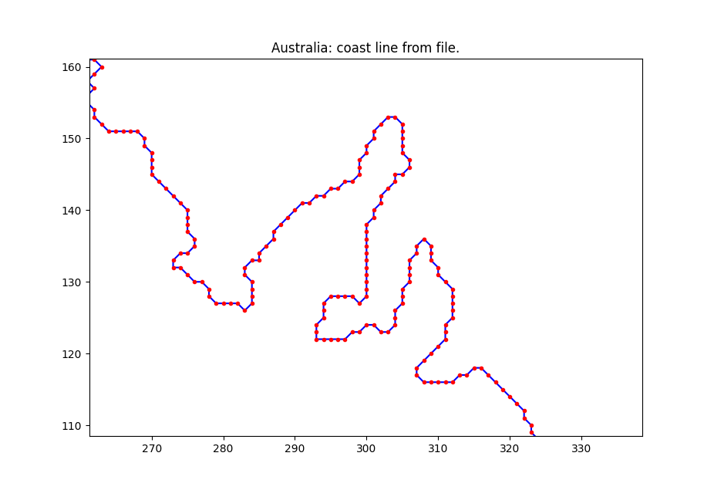
Two parts from the coast of Australia
Cape York peninsula
Show that a loop of outline isn’t made
More details:
A part of south coast
Slide 16 (north coast) may be shown for even more details.

Slide 7
Reduced from 1916 to 100 points
Ramer–Douglas–Peucker algorithm (RDP)
Greedy algorithm, several variants
Original, select 100 points, 99 lines:
Time: 28 ms
Length: 1965.4
SSE: 2720.9
RMSE: 1.19
Blue lines in plot
Remove until 100 points are left:
Time: 755 ms
Length: 1964.2
SSE: 2348.0
RMSE: 1.11
Green lines in plot

Slide 8
Reduced from 1916 to 100 points
Ramer–Douglas–Peucker algorithm (RDP)
Greedy algorithm, two variants
Add lines, from 2 to 100 points, 99 lines:
Time: 28 ms
Length: 1965.4
SSE: 2720.9
RMSE: 1.19
Blue lines in plot
Remove lines, from 1916 to 100 points:
Time: 755 ms
Length: 1964.2
SSE: 2348.0
RMSE: 1.11
Green lines in plot

Slide 9
Reduced from 1916 to 100 points
Combined RDP method, s+r+a Select 200 points Remove 100 points Adjust the remaining 100 points
RDP s+r+a:
Time: 907 ms
Length: 1937.0
SSE: 1519.2
RMSE: 0.89
Green lines in plot
Optimal solution, graph algorithm Always Forward Cardinality Constrained Shortest Path, AFCCSP:
Time: 21 s
Length: 1946.2
SSE: 1348.0
RMSE: 0.84
Blue lines in plot

Slide 10
Reduced from 1916 to 100 points
Combined RDP method, s+r+a Select 200 points Remove 100 points Adjust the remaining 100 points
RDP s+r+a:
SSE: 1519.2
Green lines in plot
Optimal solution, graph algorithm Always Forward Cardinality Constrained Shortest Path, AFCCSP:
SSE: 1348.0
Blue lines in plot
AFCCSP + fit
SSE: 1172.2
Magenta lines in plot, knots not at red points/pixels but otherwise mainly flows AFCCSP blus lines
Results made by test_39().

Slide 11
Summary of Australia results
Method | Points | Length | SSE | RMSE | Time [s]
Original | 1916 | 2259.6 | 0.0 | 0.00 | 0.000
RDP select | 100 | 1965.4 | 2720.9 | 1.19 | 0.028
RDP remove | 100 | 1964.2 | 2348.0 | 1.11 | 0.755
RDP adjust | 100 | 1937.0 | 1519.2 | 0.89 | 0.880
AFCCSP | 100 | 1946.2 | 1348.0 | 0.84 | 20.800
AFCCSP+fit | 100 | 1978.5 | 1172.2 | 0.78 | 21.222

Slide 12
Algorithms
Old problem, similarities to Linear Regression
Developed more than 100 years ago
Problem formulated as a small system of linear equations
Curve fitting (theory developed mainly 50-30 years ago)
Find piecewise polynomials or splines or Bezier curves to fit a set of points
Need fixed knots (division points)
Also formulated as a (large) system of linear equations
Matlab (also similar tools or libraries in other programs/languages)
Piecewise polynomials: ppform, splines, NURBS,
Curve fitting toolbox, NURBS, Optimization toolbox, Wavelet toolbox
MathWorks File Exchange: splinefit.m (J. Lundgren), ppfit.m (K. Skretting)

Slide 13
Algorithms
Splines and NURBS use fixed knots
Not fixed knots → more difficult problems (NP-complete)
Graph algorithms
CCSP Cardinality Constrained Shortest Path
D. Haugland and R. Nygaard at UiS (20-30 years ago)
O(MN²), N: number of points, M number of lines, NxN matrix
AFCCSP (Always forward CCSP)
New variant proposed by K. Skretting, results presented here
The restrictions makes it faster and less memory demanding
O(MNK), K max number of points forward, NxK matrix

Slide 14
Algorithms
Heuristic methods, a lot of methods including
Ramer–Douglas–Peucker algorithm (RDP)
fitMiddle (K. Skretting)
In many ways similar to RDP-adjust variant
A knot connecting two line segments can be adjusted to anywhere (“between” the two ends), not restricted to existing point between the two line ends.
With several conditions fulfilled, the knot adjustment is is done in a least-squares-optimal way, minimizing the approximation error, i.e. sum of squared errors (SSE) for all points approximated by the lines.
Matlab and Python implementations

Slide 15
Some additional slides
The following slides may be skipped
Or shown, if more examples or details are wanted
Either on Australia outline
Or actual GPX track from Melshei
Perhaps answers to particular questions?

Slide 16
Part of Australia north coast
Red dots connected by blue lines
1916 points
Simple ordering
➔ Blue outline
1141 lines (1142 points)
Length: 2259.6
Not always clear:
(294,428) – (293,428) – (293,427) – (292,429) length is 2+√5=4.236
(294,428) – (293,427) – (293,428) – (292,429) length is 1+2√2=3.828

Slide 17
Reduced to 100 points
Ramer–Douglas–Peucker algorithm (RDP)
Greedy algorithm, two variants
Add lines, from 2 to 100 points, 99 lines:
Time: 28 ms
Length: 1965.4
SSE: 2720.9
RMSE: 1.19
Blue lines in plot
Remove lines, from 1916 to 100 points:
Time: 755 ms
Length: 1964.2
SSE: 2348.0
RMSE: 1.11
Green lines in plot
This slide may be skipped.

Slide 18
Reduced from 1916 to 100 points
Always Forward Cardinality Constrained Shortest Path (AFCCSP)
AFCCSP is optimal
AFCCSP, 100 points, 99 lines:
Time: 68.5 s
Length: 1942.5
SSE: 1471.1
RMSE: 0.88
Blue lines in plot
RDP Remove lines, from 1916 to 100 points:
Time: 755 ms
Length: 1964.2
SSE: 2348.0
RMSE: 1.11
Green lines in plot
This slide may be skipped.

Slide 19
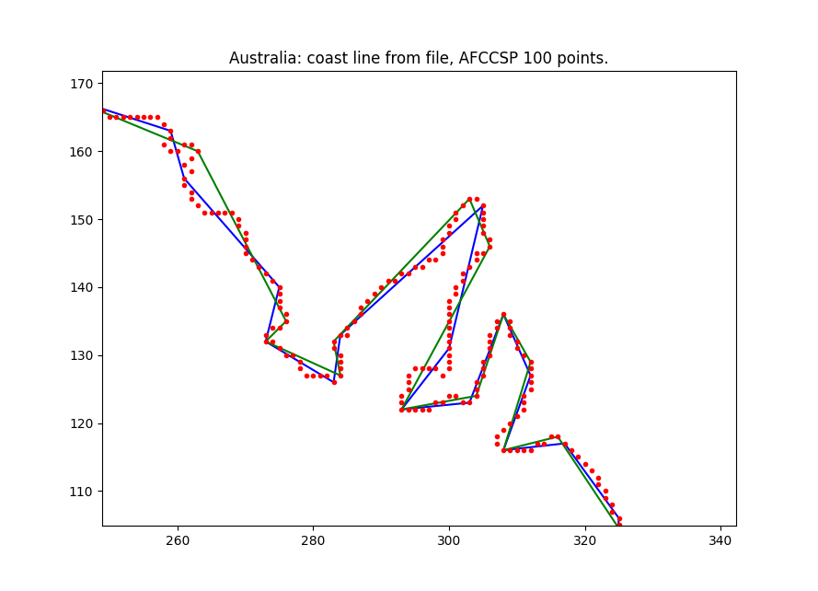
Reduced from 1916 to 100 points
Always Forward Cardinality Constrained Shortest Path (AFCCSP)
AFCCSP is optimal
AFCCSP, 100 points, 99 lines:
Time: 68.5 s
Length: 1942.5
SSE: 1471.1
RMSE: 0.88
Blue lines in plot
RDP Remove lines, from 1916 to 100 points:
Time: 755 ms
Length: 1964.2
SSE: 2348.0
RMSE: 1.11
Green lines in plot
This slide may be skipped.

Slide 20
Reduced from 1916 to 100 points
Always Forward Cardinality Constrained Shortest Path (AFCCSP)
AFCCSP is optimal
AFCCSP, 100 points, 99 lines:
Time: 68.5 s
Length: 1942.5
SSE: 1471.1
RMSE: 0.88
Blue lines in plot
RDP Remove lines, from 1916 to 100 points:
Time: 755 ms
Length: 1964.2
SSE: 2348.0
RMSE: 1.11
Green lines in plot
This slide may be skipped.

Slide 21
Start of track
May be problematic in actual cases
Large errors (Magenta)
Up to 100 m here
Reduce-algorithm makes it easier to manually edit
On point every second
Reduced to example
Two points every minute
After reduce (Blue):
And points moved
Or removed
This slide may be skipped.

Slide 22
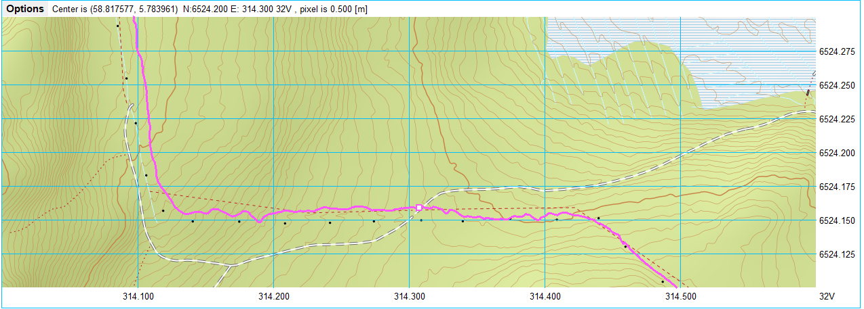
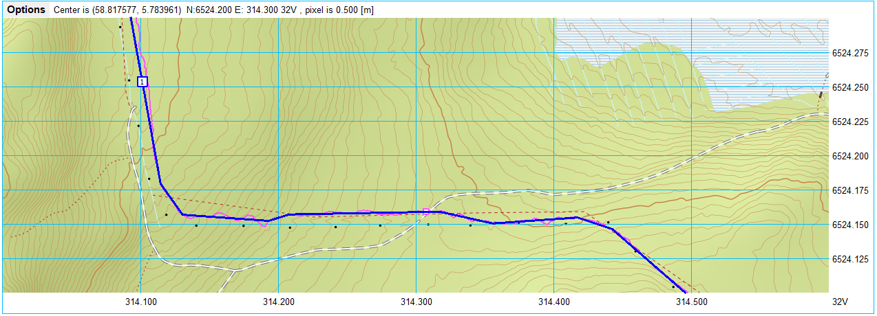
Middle of track
Original GPX-track has less errors (Magenta)
After reduce (Blue):
No manual edit necessary
What is correct?
Path from GPX
Map path, dotted lines
Map roads (skogsvei), white
Lights (lysmaster), black squares
This slide may be skipped.

Slide 23
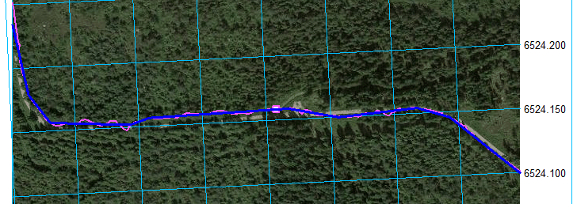
Arial view
May help, but not always
To the right, background is arial view (from Google)
Path (lysløype) is clearly visible
Also road (skogsvei) that cross the path.
Conform that GPX track is good enough for
tell where I have been
Measure distance the reduced path is more correct that the original path
This slide may be skipped.

Slide 24
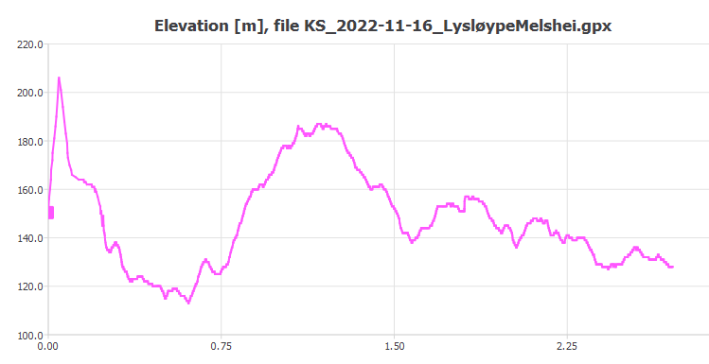
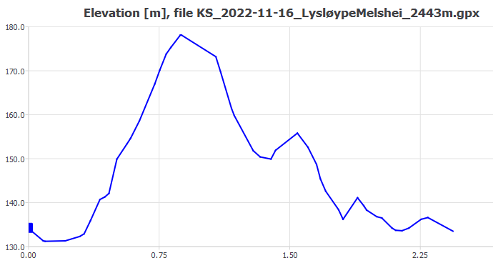
Elevation
Less accurate in GPX track
Using GPX data, error in elevation especially in the beginning.
1640 points
Total accumulated elevation 227 m
Total length 2708 m
After reduce, lookup elevation in Statkart
47 points
Total accumulated elevation 61 m
Total length 2443 m
This slide may be skipped.

